Slide 1
Infection Prevention and Control (IPC) and
Antimicrobial Resistant (AMR)
Nizam Damani

Slide 2
HAIs: Unacceptable, avoidable harm to patients…
Certain types of incidents and harm have come to seem both unacceptable and potentially preventable. The clearest example in recent times is HEALTHCARE-ASSOCIATED INFECTION, which IS NO LONGER VIEWED AS AN UNFORTUNATE SIDE EFFECT OF HEALTHCARE. With increased understanding of underlying processes, mechanisms of transmission and methods of prevention, coupled with major public and regulatory pressure, such infections are becoming UNACCEPTABLE TO BOTH PATIENTS AND PROFESSIONALS.
The measurement and monitoring of safety. Health Foundation, London, UK, 2013

Slide 3


:IPC and AMR
3.1. To reduce the global maternal mortality
3.2. To end preventable deaths of newborns & children under 5 years
3.3. To end the epidemics of AIDS, tuberculosis, malaria and neglected tropical diseases & combat hepatitis, water-borne diseases & other communicable diseases.
3.8. To achieve universal health coverage, including…, access to quality essential health-care services &… access to… vaccines for all
Infection Prevention & Control – the foundation of quality essential health services and critical to effective WASH
Notes:
IPC occupies a unique position in the field of patient safety and quality of care, as it is universally relevant to every health worker and patient, at every health care interaction
Without effective IPC it is impossible to achieve quality health care delivery and strong health systems

Slide 4
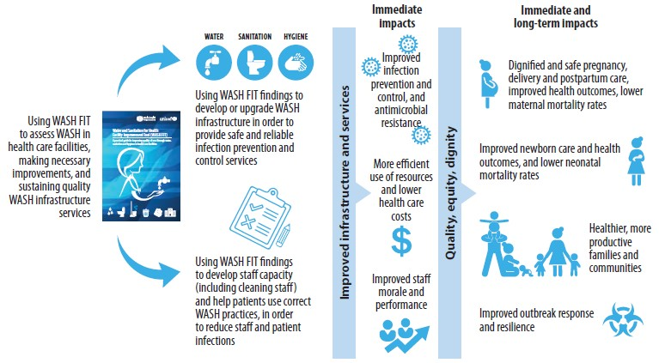
Impacts associated with WASH FIT

Slide 5
Link between Healthcare facility and community
HEALTH CARE FACILITY
HEALTH CARE–ASSOCIATED INFECTIONS
CROSS-INFECTION
of Multidrug-resistant organisms (MDROs)
& Communicable Diseases
COMMUNITY
Spread of Multidrug-resistant organisms (MDROs) & Communicable Diseases

Slide 6
IPC and AMR: A key part of people centered and
integrated health services
1
`
Universal Health Coverage
IPC programmes based on evidence-based norms & standards, embedded at the national & local level as a key part of people centered & integrated health services
Safety and Quality
Palliation
Promotion
2
Promote & prevent
People
Rehabilitation
Prevention
Treatment
3
Avoidable harm (patients and health workers);
Contributes to a reduction in health care costs (health facilities & nations, and out of pocket patient expenditure)
Storr J, Kilpatrick C, Allegranzi B, Syed SB (2016). Redefining infection prevention and control in the new era of quality universal health coverage. Journal of Research in Nursing Vol. 21(1) 39–52
Notes:
Prevention is one of 5 fundamental elements of people centered & integrated health services
IPC prevents an voidable harm to both pts and HCWs that is HAIs, a universally relevant threat to anyone accessing health care
IPC is recognized as playing a strong role – with the emphasis on low
cost interventions, applicable to all providing care, preventing microbial spread and
therefore avoiding the need for antibiotic treatment.

Slide 7
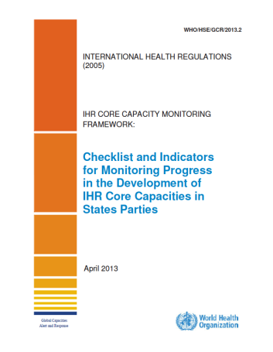
A key strategy for preparing for and dealing with public health threats of international concern
Focus on the global health security agenda and International Health Regulations (IHR) which position IPC as a key strategy for dealing with public health threats of international concern.
Remember – IHR is the only international “law” that addresses IPC
IPC is an IHR Core Capacity!

Slide 8
Antimicrobial Resistant (AMR)

Slide 9
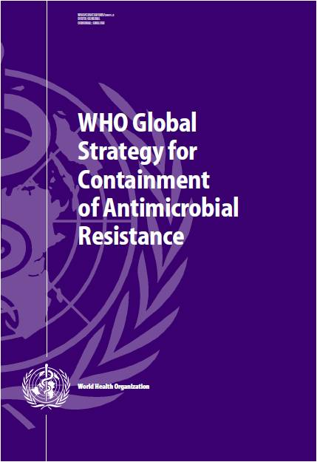
Control of AMR is a global issue : 2001
Development and implementation of antibiotic policies
Education of medical staff in appropriate use of antimicrobial agents
Resources to establish microbiology laboratory
Establish national surveillance of MDROs
Implementation of basic infection control precautions
9/11/2001
Notes:
In order to address this issue, the WHO did have a policy which was launched 15 years ago on 9/11 and therefore it went completely unnoticed

Slide 10
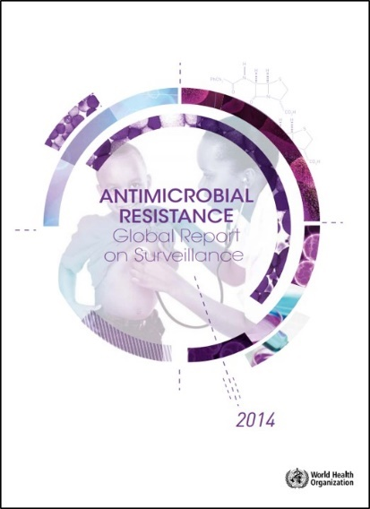
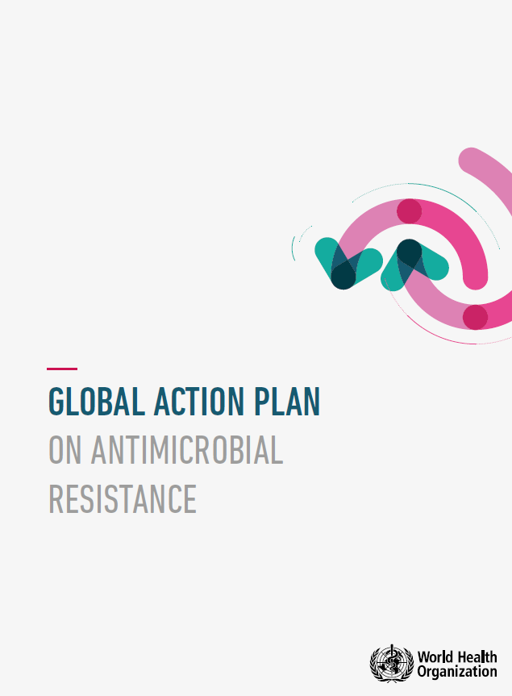

Slide 11
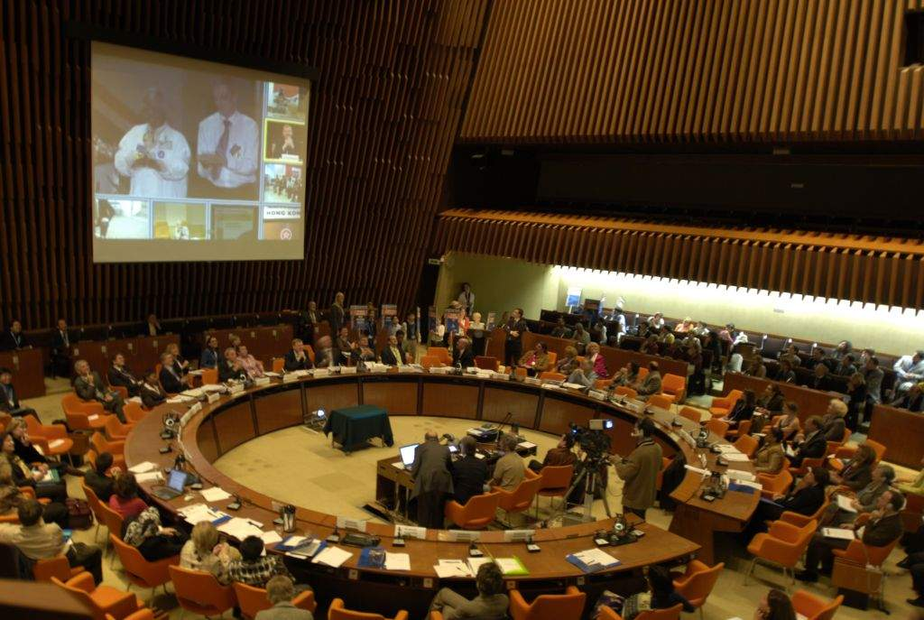
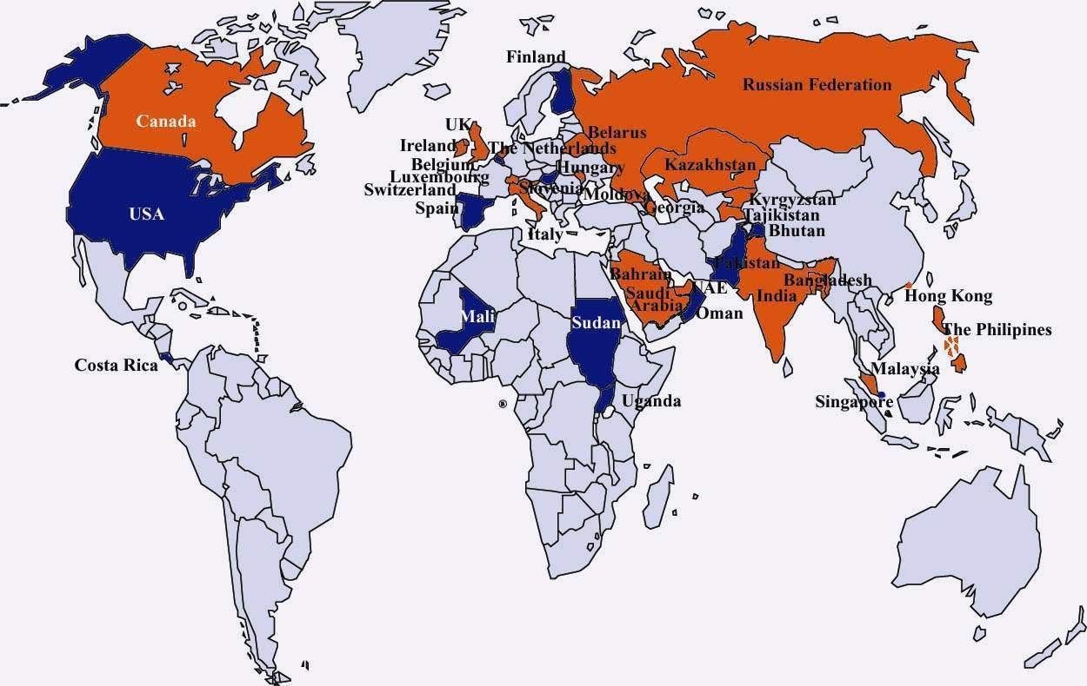
Countries committed to addressing HAI
Antimicrobial Resistance
Global action Plan
69 World helath Assembly
28,May 2016
WHO HQ, Geneva
Ministerial Pledges
Countries committed in 2005-2006
Countries planning to commit in 2006

Slide 12




Slide 14
AMR Global Action Plans & National Action Plans
Global strategic objectives
Examples of key actions for national action plans
1. Improve awareness and understanding of AMR
Risk communication
Education
2. Strengthen knowledge through surveillance and research
National AMR surveillance system
Laboratory capacities
3. Reduce the incidence of infection through effective sanitation, hygiene and infection prevention measures
IPC in health care (incl. liaison with WASH)
Community level prevention (incl. liaison with WASH)
4. Optimize the use of antimicrobial medicines
5. Ensure sustainable investment in countering antimicrobial resistance
Animal health
Access to qualified antimicrobial medicines
Research and development
Animal health
Measuring the burden of AMR
Assessing investment needs
Establishing procedures for participation

Slide 15
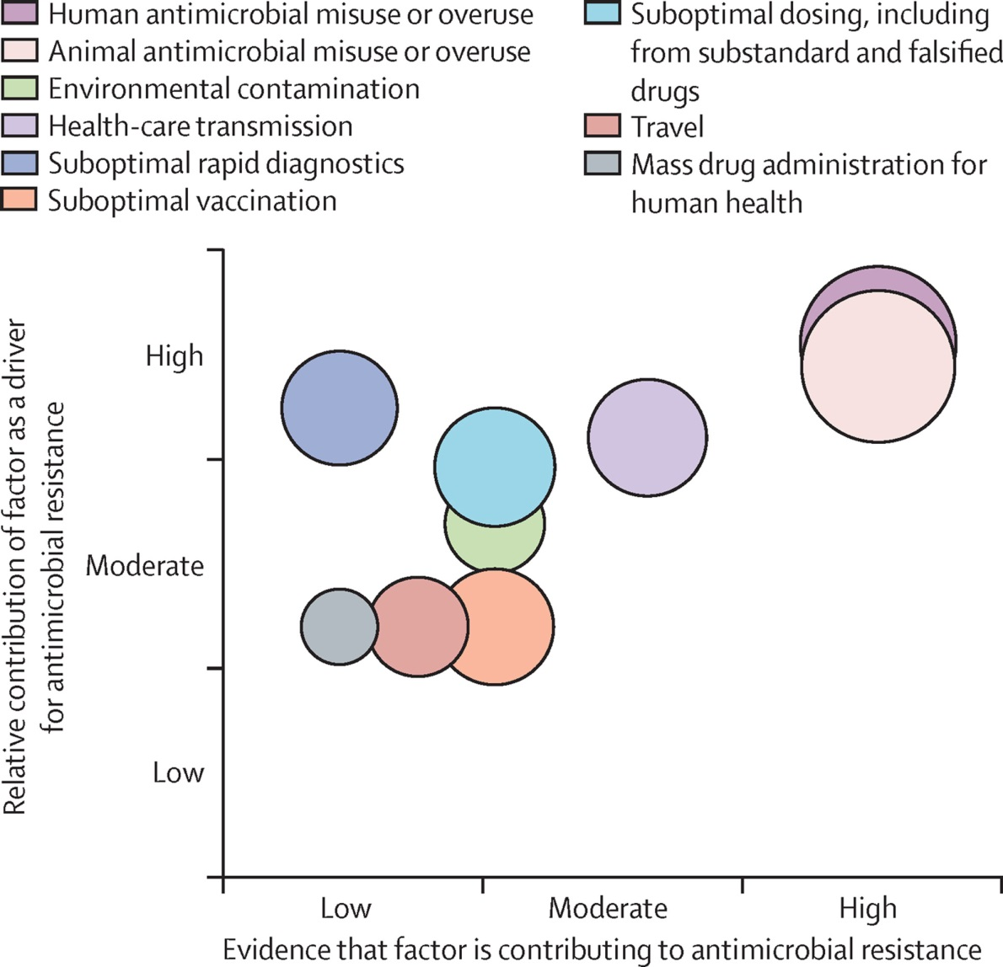
Factors Contributing to Antimicrobial resistance (AMR)
Antibiotic Consumption
HCF transmission
Holmes AH, et al. Lancet 2016 Jan 9;387(10014):176-87.
Notes:
Human and animal misuse-over use are driving AMR

Slide 16

A Sense of Perspective
WHERE USED
TYPES OF USE
Questionable use
20%
hospital
20-50%
50%
80%
unnecessary
HUMAN
Community
20%
50%
therapeutic
40-80%
80%
ANIMAL
Highly
questionable
Prophylaxis/
growth
promotion
Wise et al. BMJ 1999; 317: 609-610

Slide 17
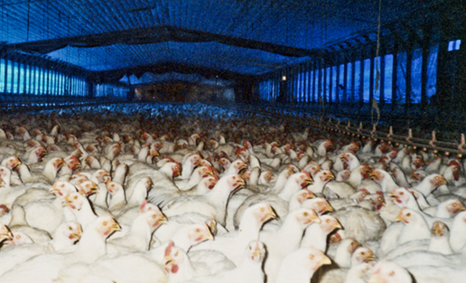
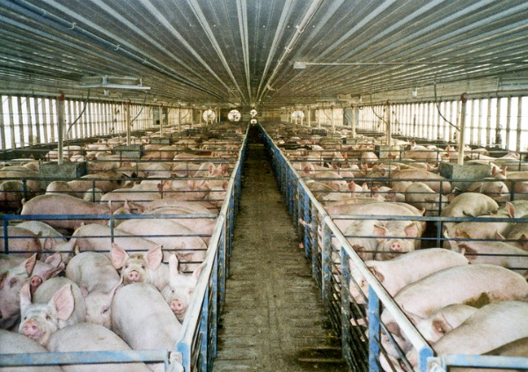
Use of antibiotic in Animals

Slide 18
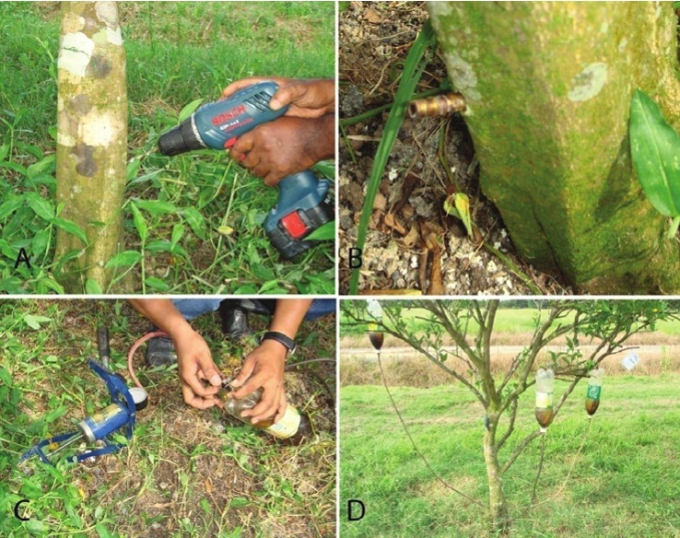
Use of antibiotic in agriculture
Making a hole on the trunk of the tree
Preparing the antibiotic container
IV antibiotic drip
Preparing the antibiotic container
Whole antibiotic injection set up like a drip !.

Slide 19

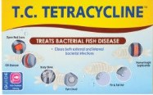
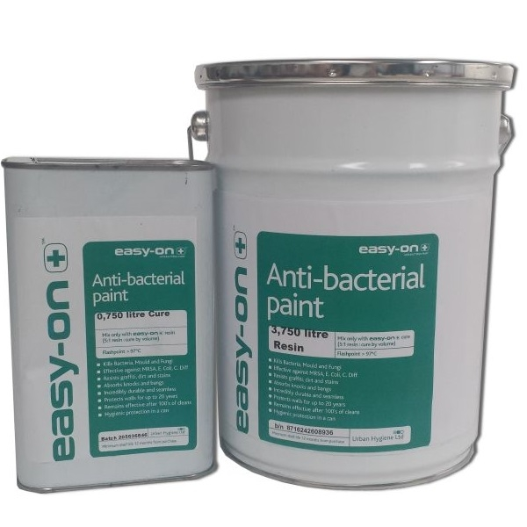


Slide 20

One Health Triad

Slide 21
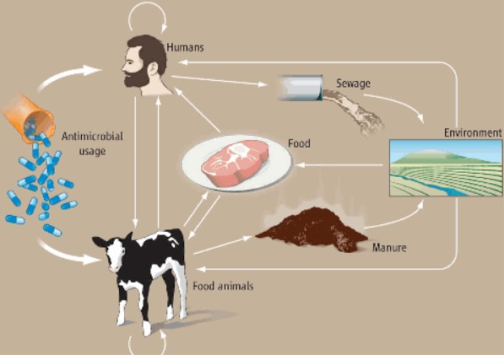
Antimicrobial Resistance: a One Health Perspective
McEwen SA, eta al. Microbiol Spectr 2018;6(2).

Slide 22

Birds spread antibiotic resistant bacteria everywhere
Sjöund et al. Emerging Infectious Diseases 2008, 14: 70-72.
Photo: J Bonnedahl

Slide 23
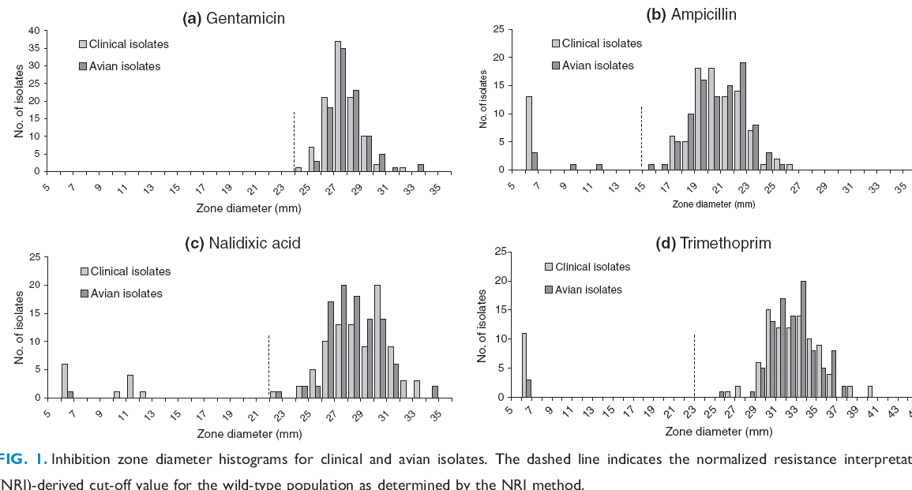
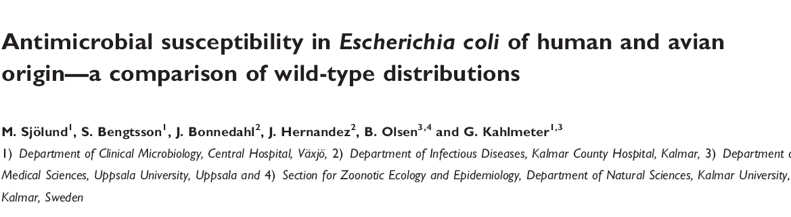
”Arctic shit” study”
E. coli isolated from fecal samples from
chick geese showed resistance to several antimicrobials!
Emerging Infectious Diseases 2008, 14: 70-72.

Slide 24

International Travel

Slide 25




One Health Approach
To combat Antibiotic resistance
Notes:
and infection Prevention and control

Slide 26
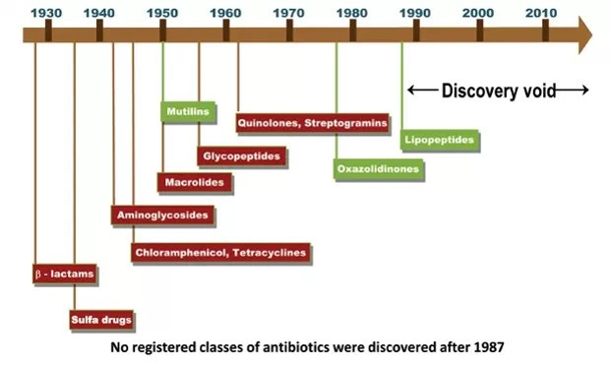
Antibiotic Discovery Void
For treatment of
multidrug-resistant
GRAM-POSITIVE bacteria
http://econlife.com/2014/05/a-slower-pace-of-technological-innvovation/

Slide 27
Antibiotic stewardship
‘The development of new antibiotics without having mechanisms to insure their appropriate use is much like supplying your alcoholic patients with a finer brandy.
Dennis Maki 1998

Slide 28
Global burden of Antimicrobial resistance (AMR)
TUBERCULOSIS
  440 000 new MDR-TB cases annually
  XDR-TB reported in 58 countries
  Cost of 1 MDR patient (50 % mortality rate) = 100 patients with fully sensitive TB
MALARIA (Plasmodium falciparum)
  Artemisinin resistance linked to monotherapy
HIV
  With expanded use of antiretroviral, resistance now a concern (6-8% resistant)
GRAM-POSITIVE
  Methicillin-resistant Staph. aureus (MRSA)
  Multi-resistant species of coagulase negative Staphylococci
  Vancomycin-resistant enterococci (VRE)
  Penicillin resistant Strep.pneumoniae (PRP)
GRAM-NEGATIVE BACILLI
  (Extended-spectrum β-lactamases (ESBL) & carbapenem-resistant Enterobacteriaceae (CRE)
  E coli, Klebsiella spp., Enterobacter spp., Citrobacter spp., Serratia spp., Pseudomonas spp.,Acinetobacter spp. .
  Increasing resistance in gonorrhoea and shigellosis
Notes:
This slide summarizes the list of AMR. However, my purpose of today’s presentation, I will concentrate only on Gram negative organisms esp. carbapenem-resistant Enterobacteriaceae (CRE)

Slide 29
Carbapenem-resistant Enterobacteriaceae (CRE)
Extended-spectrum β-lactamases (ESBL)
Resistance to all β lactam & cephalosporins antibiotics ± others
Often treated with IV meropenem, imipenem, doripenem and ertapenem
Carbapenem-resistant Enterobacteriaceae (CRE)
Carbapenem (IV meropenem, imipenem & ertapenem) and all other antibiotics
No treatment except IV Colistin !
Notes:
he spread of NDM illustrates that antibiotic resistance is a public health problem that transcends national borders and will require international cooperation between health authorities if it is to be controlled.

Slide 30

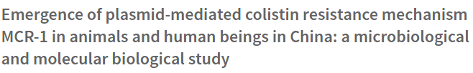
Carbapenem-resistant Enterobacteriaceae (CRE)
Last-resort antibiotics!
Organisms Resistance to Colistin
2015: mcr-1 gene identified in E.coli in China
Notes:
he spread of NDM illustrates that antibiotic resistance is a public health problem that transcends national borders and will require international cooperation between health authorities if it is to be controlled.

Slide 31
WHO priority pathogens list for
Research and development of new antibiotics
(27th February 2017)
Priority 1: CRITICAL
  Acinetobacter baumannii, carbapenem-resistant
  Pseudomonas aeruginosa, carbapenem-resistant
  Enterobacteriaceae: carbapenem-resistant CRO), ESBL-producing
Priority 2: HIGH
  Enterococcus faecium, vancomycin-resistant
  Staphylococcus aureus, methicillin-resistant, vancomycin-intermediate and resistant
  Helicobacter pylori, clarithromycin-resistant
  Campylobacter spp., fluoroquinolone-resistant
  Salmonellae, fluoroquinolone-resistant
  Neisseria gonorrhoeae, cephalosporin-resistant, fluoroquinolone-resistant
Priority 3: MEDIUM
  Streptococcus pneumoniae, penicillin-non-susceptible
  Haemophilus influenzae, ampicillin-resistant
  Shigella spp., fluoroquinolone-resistant

Slide 32
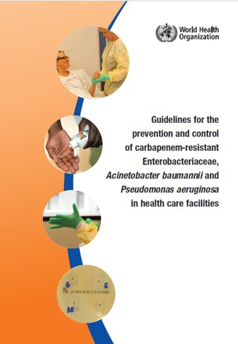
WHO Guidelines on Carbapenem-resistant organisms
WHO
CRO Implementation
Tool
(to be published soon)

Slide 33
Antibiotic stewardship

Slide 34
Antibiotic stewardship
Aim of the antibiotic stewardship programme is to
reduce inappropriate use of antibiotics
  This objective cannot be achieved only by monitoring compliance with the local guidelines

Slide 35
Antibiotic stewardship
Monitoring data should include:
  Document reason for prescribing
  Was antibiotic(s) is really needed ?
    Infection vs colonization ! etc…
    (Treating the positive bacteriology report and not the patient !)
    Bacterial vs viral infections
    Non-infective causes of fever
  Right antibiotic was prescribed as per local guideline
  Right dose
  Right duration

Slide 36
Antibiotic Consumption in the Southern Trust and C. difficile
Monitoring of antibiotic compliance
C diff
MCory A, Damani N et al. British Journal of Clinical Pharmacy 2010;2: 341-344

Slide 37

Antibiotic ward rounds

Slide 38
Antibiotic ward rounds

Slide 39
Feedback of information to Consultants

Slide 40
Antibiotic Ward Rounds
One registrar doctor prescribed prophylactic antibiotics for one year to prevent UTI in a 78 year old catheterized patient!

Slide 41
Antibiotic Consumption in the Southern Trust and C. difficile
Start of antibiotic ward rounds CAH & DHH
Monitoring of antibiotic compliance
C diff
High risk antibiotic group
MCory A, Damani N et al. British Journal of Clinical Pharmacy 2010;2: 341-344

Slide 42
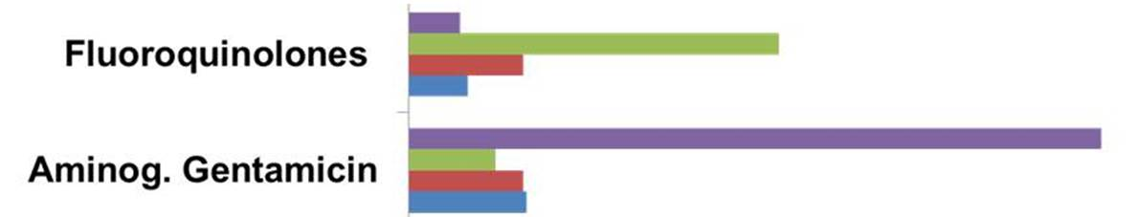
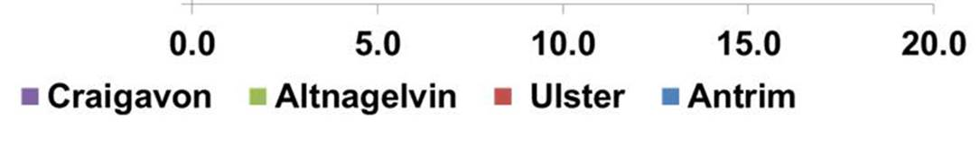
Antibiotic consumption in four Trusts N. Ireland
High Risk
Low Risk

Slide 43
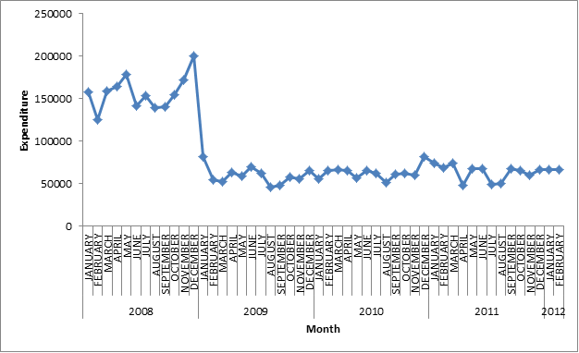
Antibiotic expenditure in the Southern Trust
(All adult inpatients)
Start of antibiotic ward rounds CAH & DHH
150 k/month
80 k/month
MCory A, Damani N et al. British Journal of Clinical Pharmacy 2010;2: 341-344

Slide 44
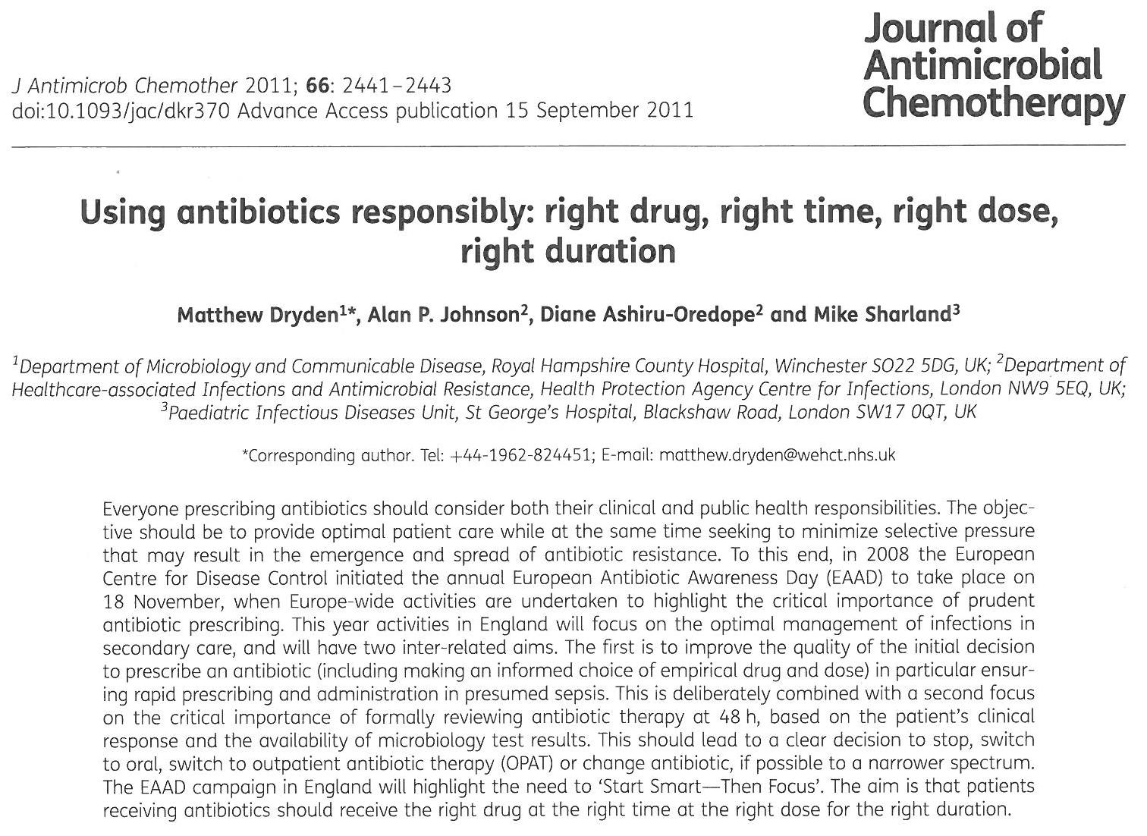
The main aim of the Antibiotic Stewardship Programme is to reduce inappropriate prescribing to preserve current compounds !

Slide 45
AMR Global Action Plans & National Action Plans
Global strategic objectives
Examples of key actions for national action plans
1. Improve awareness and understanding of AMR
Risk communication
Education
2. Strengthen knowledge through surveillance and research
National AMR surveillance system
Laboratory capacities
3. Reduce the incidence of infection through effective sanitation, hygiene and infection prevention measures
IPC in health care (incl. liaison with WASH)
Community level prevention (incl. liaison with WASH)
4. Optimize the use of antimicrobial medicines
5. Ensure sustainable investment in countering antimicrobial resistance
Animal health
Access to qualified antimicrobial medicines
Research and development
Animal health
Measuring the burden of AMR
Assessing investment needs
Establishing procedures for participation

Slide 46
Infection Prevention and Control

Slide 47
Factors Contributing to AMR
HCF transmission
Holmes AH, et al. Lancet. 2016 Jan 9;387(10014):176-87.
Notes:
Human and animal misuse-over use are driving AMR

Slide 48
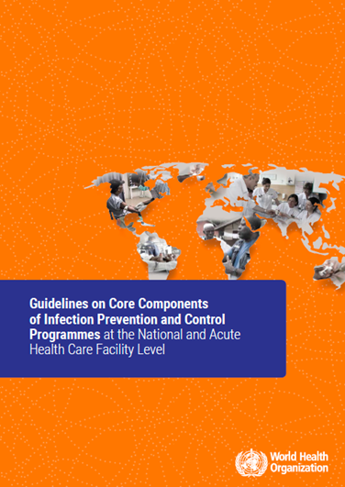
WHO IPC Core Component

Slide 49
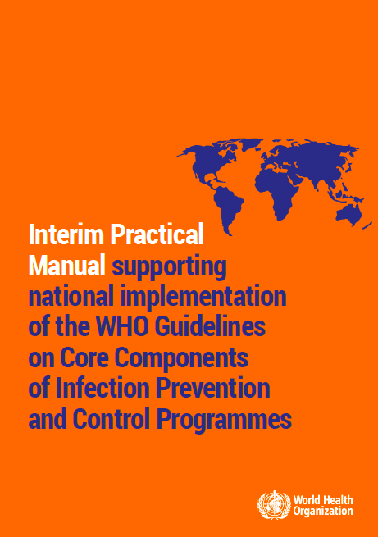
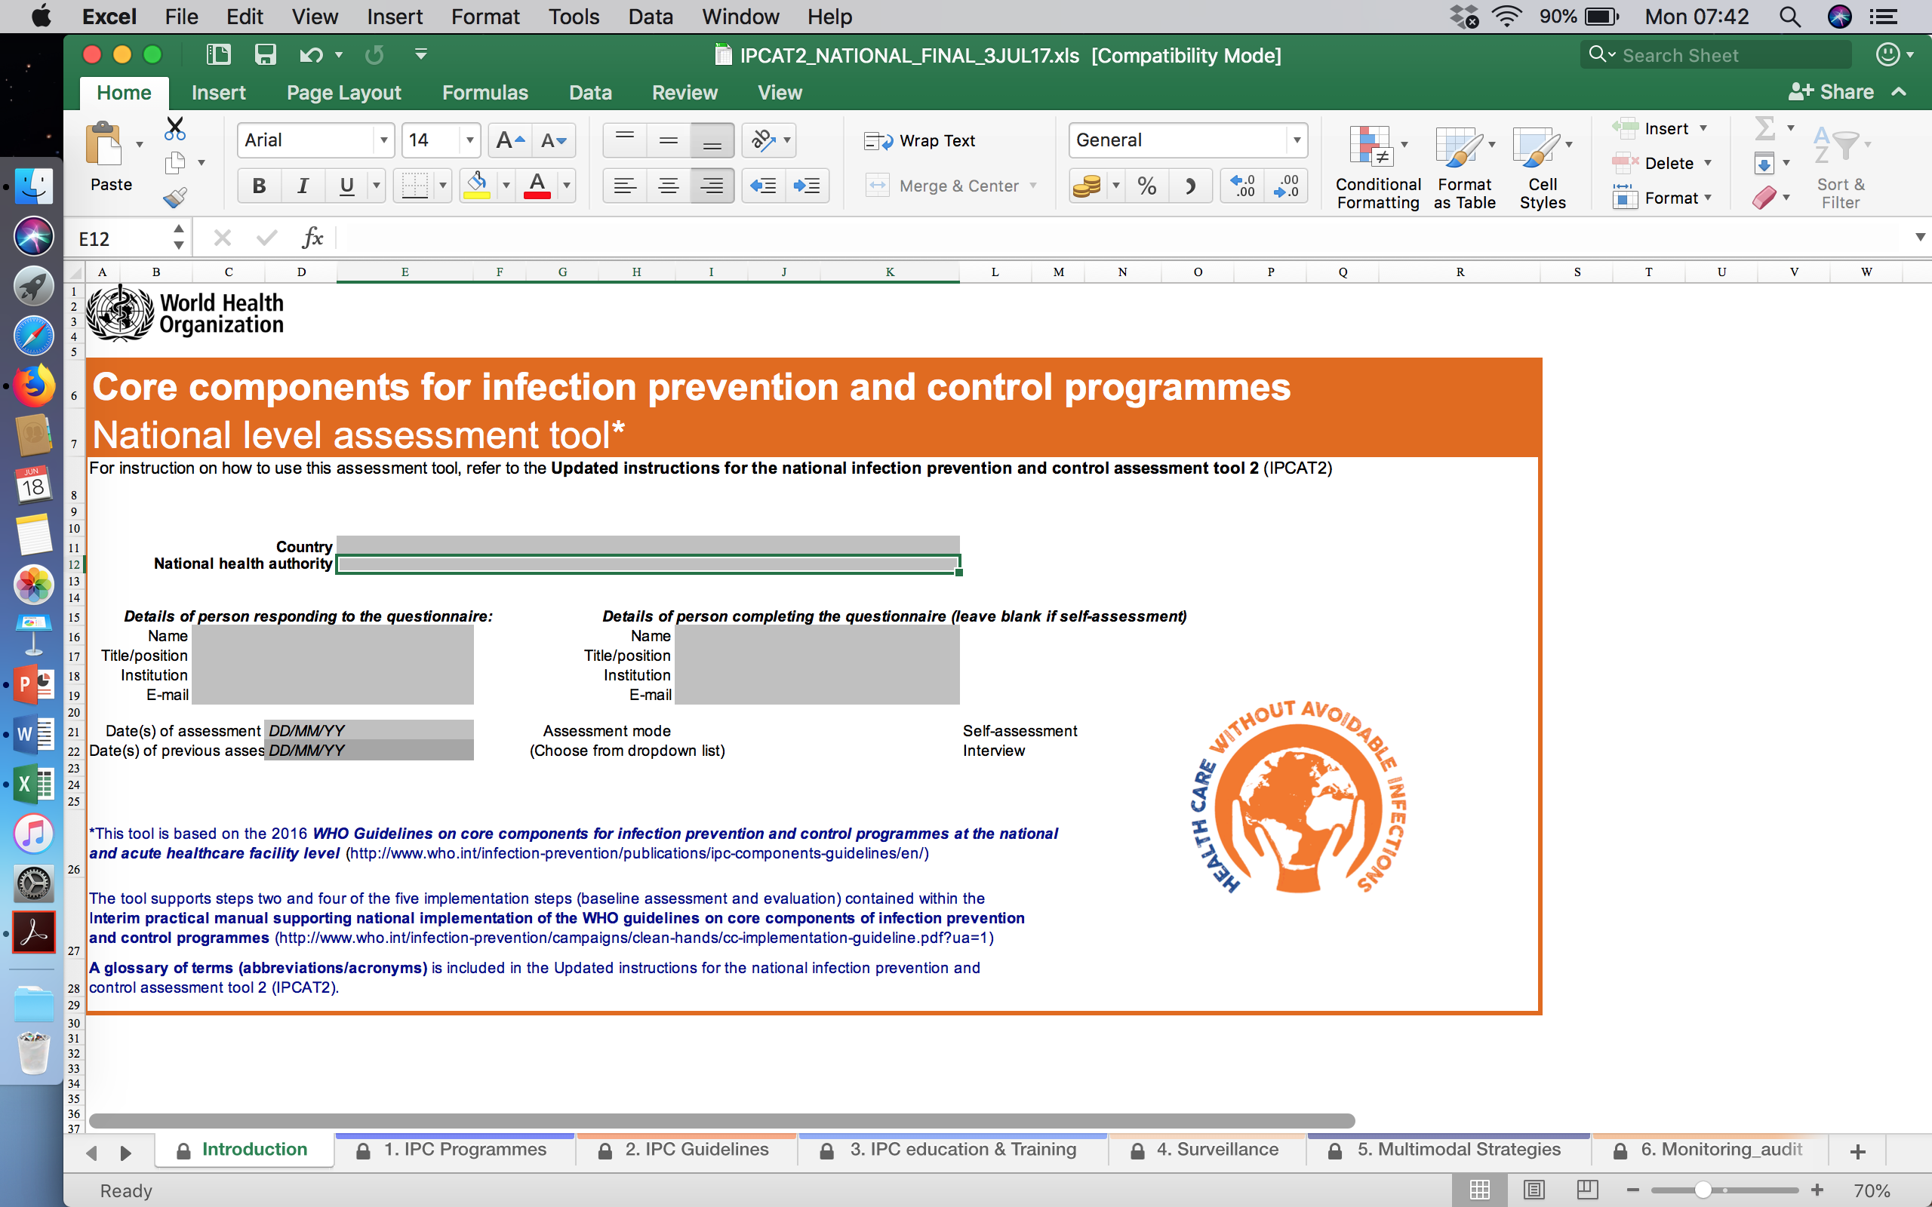

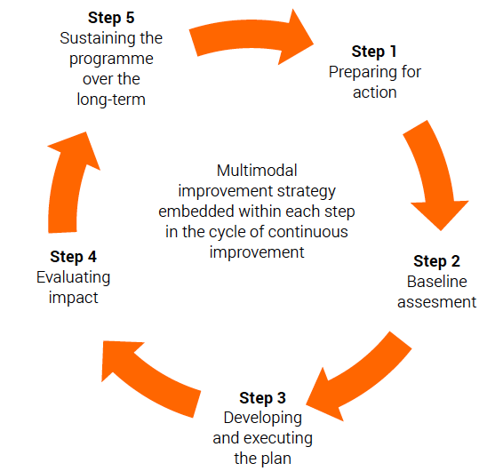


The IPC implementation approach
National
IPCAT2
IPC Assessment Tool
Implementation packages
5-Step implementation cycle
WHO Core Component Guidelines
Healthcare facility
IPCAF
IPC Assessment framework

Slide 50
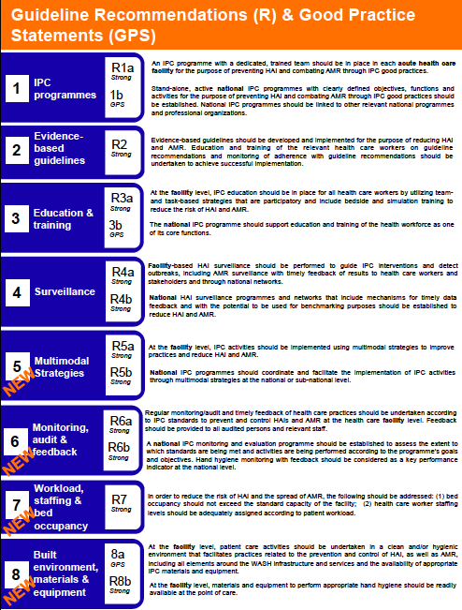
Eight Recommendations of Core Component
National Level
Healthcare Facility Level

Slide 51
Vertical interventions vs Horizontal interventions
to control all antibiotic resistant bacteria
VERTICAL INTERVENTIONS
(organism-specific measures)
Screening for antibiotic
resistant organisms
Placement of patient in isolation room
with contact precautions
Targeted decolonization
e.g. MRSA
HORIZONTAL INTERVENTIONS
(To control all HAIs microorganisms)
Antibiotic stewardship, hand hygiene,
minimum use of invasive devices,
decontamination of items and equipment, cleaning
and/or disinfection of environment etc.
Aims to prevent transmission of all MDROs
MDROs

Slide 52
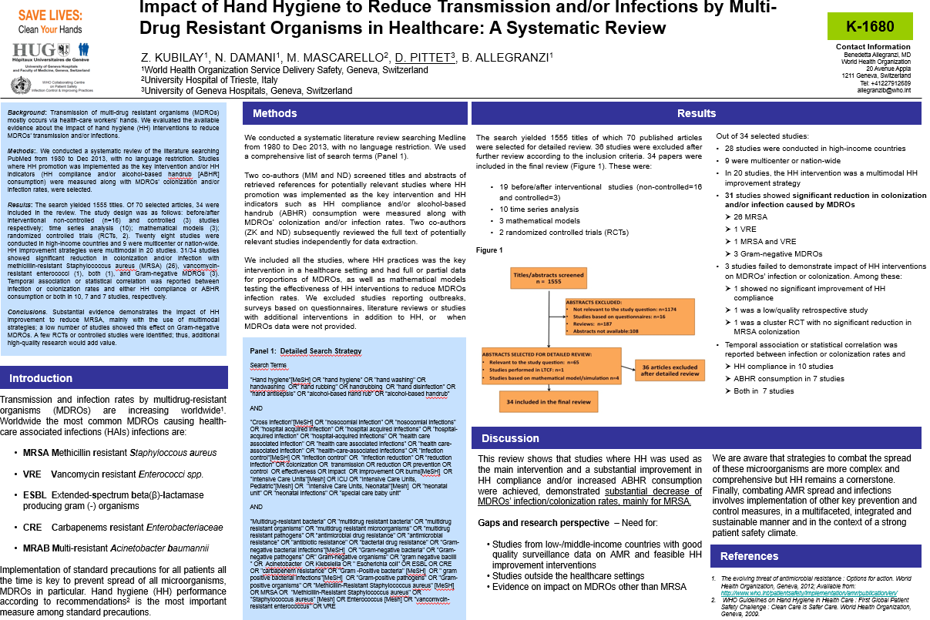
Systematic review
Conclusions
Substantial evidence demonstrates the impact of HH improvement to reduce MRSA, mainly with the use of multimodal strategies; a low number of studies showed this effect on Gram-negative MDROs.
Notes:
1500 total papers . 34 were included in the review

Slide 53
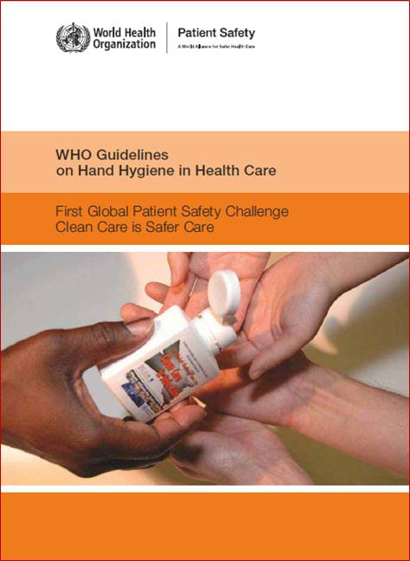
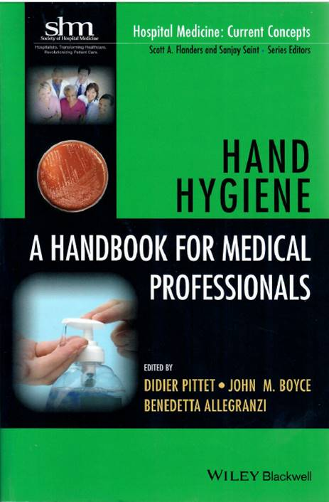
2009
2017

Slide 54
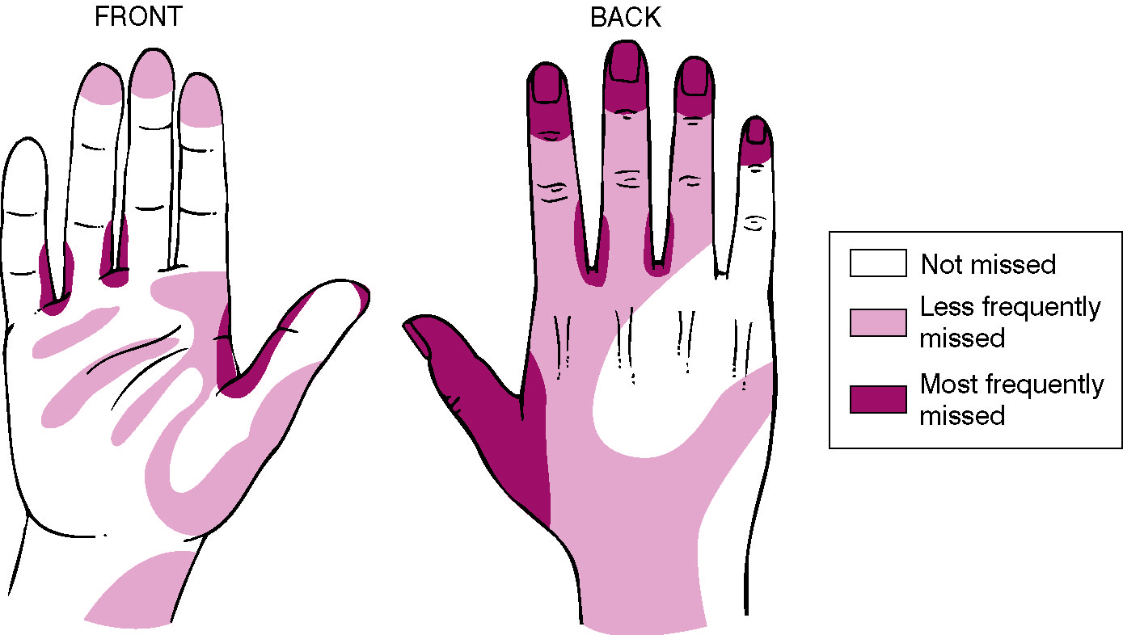
Hand Hygiene

Slide 55
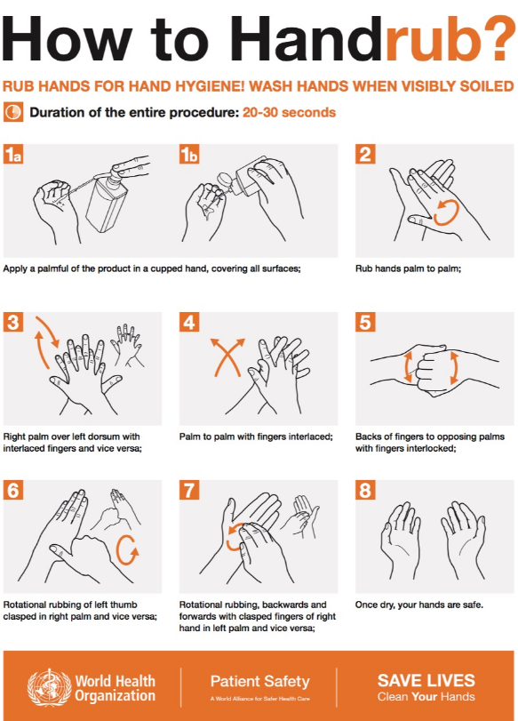
Pires D, et al. Revisiting the WHO ‘How to handrub’ hand hygiene technique: fingertips first? Infect Control Hosp Epidemiol 2017;38:230– 33.

Slide 56
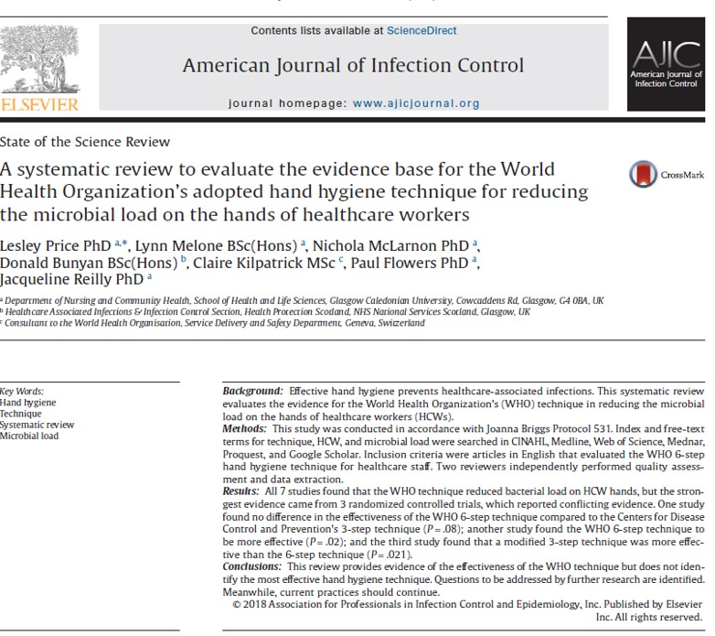
CONCLUSIONS
This review provides evidence of the effectiveness of the WHO
technique but does not identify the most effective hand hygiene technique.
Questions to be addressed by further research are identified.
Meanwhile, current practices should continue.
Price L, et al. American Journal of Infection Control 2018; 46(7)814–823

Slide 57
Requirement for effective hand hygiene
Approved product
  EN : European norms
  WHO formulations meet both EN (European) and ATSM (US) norms.
Formulation
  Alcohol based hand rub, gel or foam
Correct concentration of alcohol
  70-80%
  Concentrations higher than 90% are less effective because proteins are not denatured easily in the absence of water
Correct amount to cover all parts of hand
  ~ 3 ml or palm full
Contact time

Slide 58
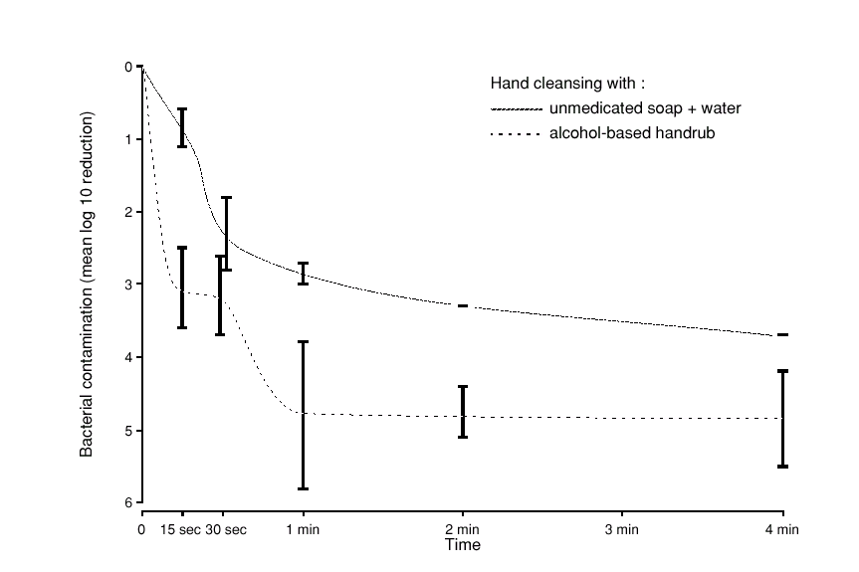
Application time of hand hygiene (handwashing and handrubbing) and reduction of bacterial contamination
Hand rubbing with ABHR is:
More effective
Faster
Better tolerated
Pittet and Boyce, Lancet Infectious Diseases 2001
Notes:
After 15-30 seconds only, handrubbing is significantly more efficient than handwashing with plain soap and water, to reduce hand bacterial contamination.

Slide 59
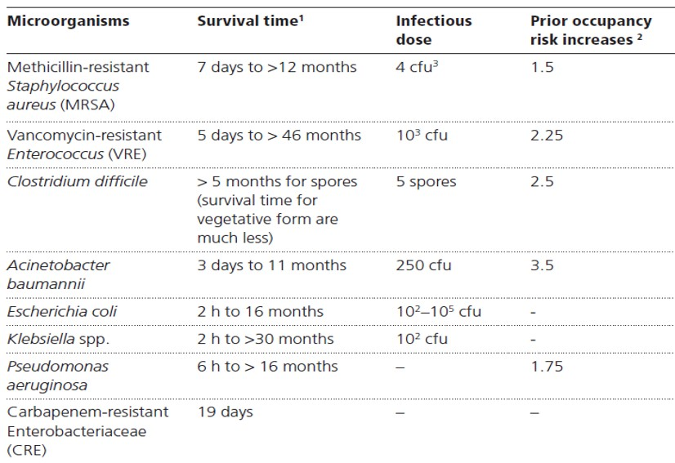
Risk associated with the room been previously occupied by patients infected with common pathogens
Damani N. Manual of Infection Prevention and Control (4ed). Oxford: Oxford University Press, 2019.

Slide 60
Summary of key elements to control and prevent spread of Antibiotic resistant bacteria
Antibiotic stewardship
Monitoring of prudent use antibiotics
Triage
and identification by screening of known/suspected patients
Isolation of patient with contact precautions
Cleaning and/or disinfection of environment
Decontamination
Items and equipment
Use of aseptic technique
Education & training
of medical all healthcare workers in IPC and medical staff on Antibiotic prescribing
Surveillance
Antibiotic resistant bacteria and HAIs
Monitoring
of IPC practices

Slide 61
Antibiotic Stewardship
is essential to
PREVENT SELECTION
OF RESISTANT BACTERIA
INFECTION CONTROL PRACTICES
are essential to prevent
SPREAD OF RESISTANT BACTERIA

Slide 62
Correct Answers : AMR
No. | Questions | YES | NO
1 | Effective Antibiotic Stewardship solely requires monitoring of compliance with local antibiotic guidelines in healthcare facilities.
2 | Control of multi-drug resistant organisms (MDROs) requires only the implementation of contact precautions.
3. | Antibiotic(s) development in dealing with the treatment of MDROs both Gram-positive and Gram-negative have equal priorities.

Slide 63
Correct Answers : IPC
No. | Questions | YES | NO
1 | There is an international uniformity on all the elements to be included in IPC Standard Precautions.
2 | To achieve effective hand hygiene, it is essential that healthcare workers must follow all the steps in exact sequence as outlined in the WHO Hand Hygiene poster.
3. | All hand hygiene products available on the market are equally effective.

Slide 64
Thank you

