Slide 1

Antimicrobial Stewardship – Northern Ireland Experience
Regional Antimicrobial Pharmacists Network
A Seventeen Year Journey!

Slide 2
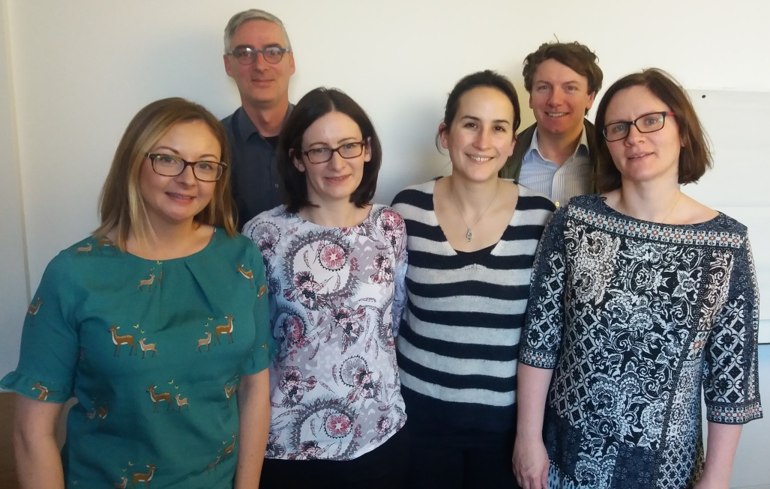
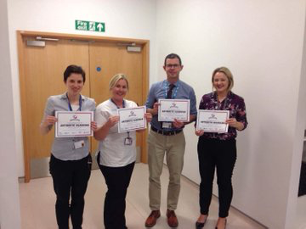
Notes:
Presenting on behalf of the regional antimicrobial pharmacist’s network
Antibiotic guardian.1

Slide 3
The beginning……….
Antimicrobial Resistance Action Plan (AMRAP) Launched 2002
6 priority areas for action
  Prudent antimicrobial use in community
  Prudent antimicrobial use in hospitals
  Infection control
  Prudent antimicrobial use in animals
  Education, information dissemination
  Research and surveillance
Antimicrobial pharmacist employed in NHSCT and WHSCT
Notes:
Now there is 1.5 WTE in each of the trusts and additional OPAT pharmacists starting out

Slide 4
Guideline Development
Individual Trust Guidelines
Regional Framework for Antibiotic Prescribing
Regional Neonatal Guidelines
Regional Vancomycin Guidelines
Regional Kardex with Antimicrobial prescribing section
Mobile App for Antibiotic Guidelines
2019
2008

Slide 5




Education
NI Regional Antimicrobial Pharmacists Group
Notes:
QUB- FY0 assistantship- multiprofessional training with microbiologist and pharmacist
Pharmacy undergraduate Taster sessions with specialist antimicrobial pharmacists
Advanced pharmacy practice- antimicrobial workbook, workshop and OSCE
Ulster University- presentation to final year pharmacy undergraduates
HSB northern Ireland- podiatry training
NICPLD- workshop with independent prescribers and review and update of the antimicrobial stewardship modules available to all healthcare professionals

Slide 6
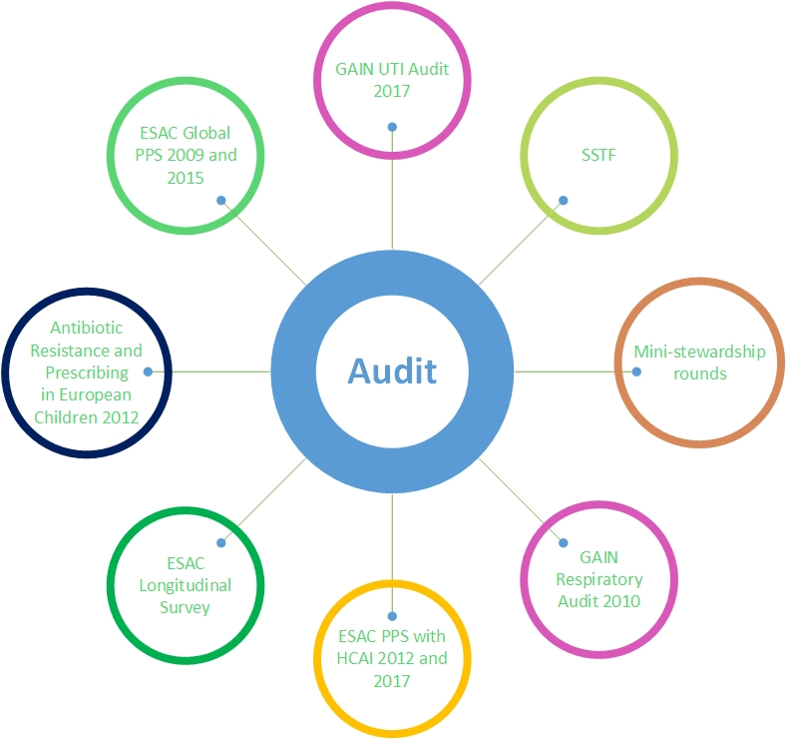
Notes:
From GAIN UTI audit 2017 … “Of the data reviewed, in 90% (273 of 303) of all prescribed antibiotics, duration was too long for uncomplicated UTI.”
“The regional kardex does have a prompt to review therapy at Day 3; however the audit showed that this prompt is not effective.”
ESAC PPS with HCAI- 2017

Slide 7
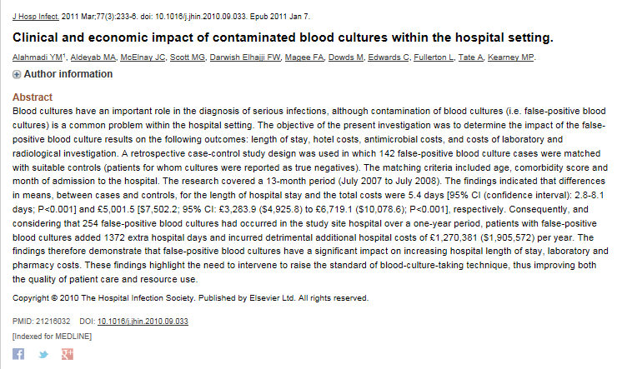
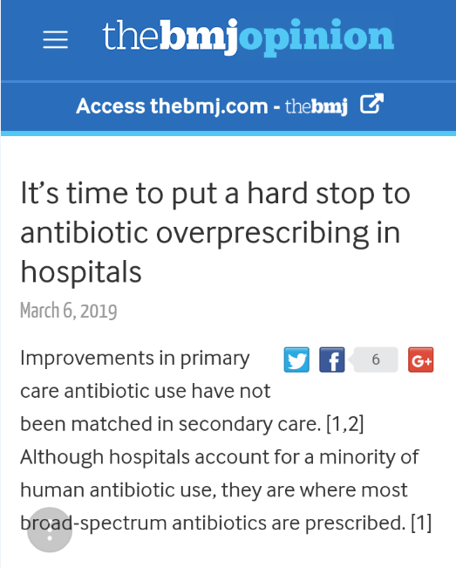
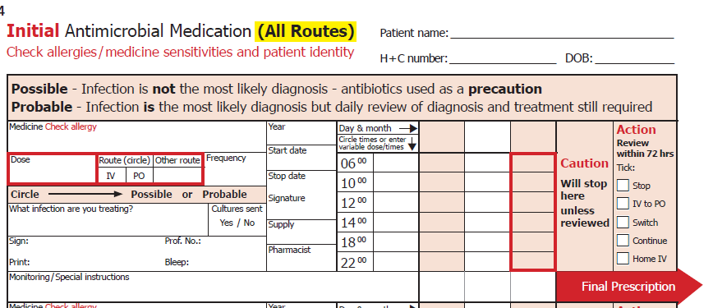
Research: Behavioural Change
Behavioural Change:
ARK Multi-Centre Study.
Qualitative and quantitative study to explore reasons why Junior Doctors do not follow antibiotic guidelines.
Investigation of the effects of an educational intervention on blood culture contamination rates in an ICU setting.
Notes:
BEHAVIOURAL CHANGE:
1. ARK- Know that 90% of patients are reviewed within 72 hours however it is continue with the same ABX, 4 trusts taking part, one trust saw an increase in stop rate to ___ whilst undertaking main implementation. All 4 trusts are implementings on various scaless.
2. 60% OF SURVEY PARTICIPANTS REGULARLY PRESCRIBE ANTIBIOTICS OUTSIDE OF GUIDELINES. SENIOR DOCTORS HAVE A LARGE ROLE TO PLAY.
3. 5.8% REDUCTION IN BCC FOLLOWING EDUCATIONAL INTERVENTION RESULTING IN A COST SAVINGS OF £250,000.
The research covered a 13-month period (July 2007 to July 2008). The findings indicated that differences in means, between cases and controls, for the length of hospital stay and the total costs were 5.4 days respectively.
The findings therefore demonstrate that false-positive blood cultures have a significant impact on increasing hospital length of stay, laboratory and pharmacy costs. These findings highlight the need to intervene to raise the standard of blood-culture-taking technique, thus improving both the quality of patient care and resource use.
EPIDEMIOLOGY:
Fluoroquinolones sig associated with CDI, FQ, co-amoxiclav and macrolides sig associated with MRSA
Cycling associated with a sig decrease in taz and co-amoxiclav resistance among ESBL isolates.
Thresholds for fq, and cephalosporins identified for MRSA for Antrim Hospital part of a pan European Study, field study being investigated inn Antrim.
Infection Control:
1. Introduction of a chlorine based disinfectant resulted in a decrease of HA-MRSA by up to 4 cases/month, cost savings £276,000
1.

Slide 8
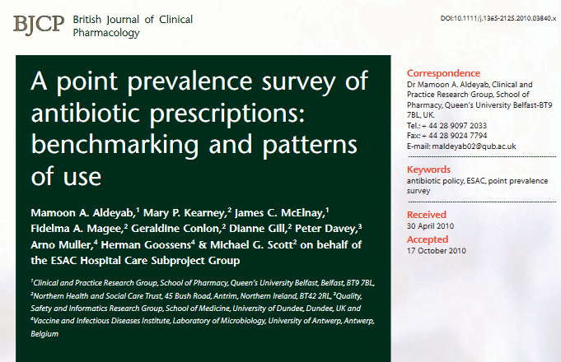
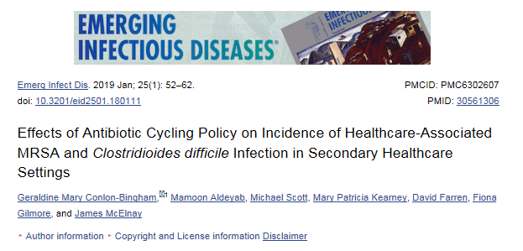
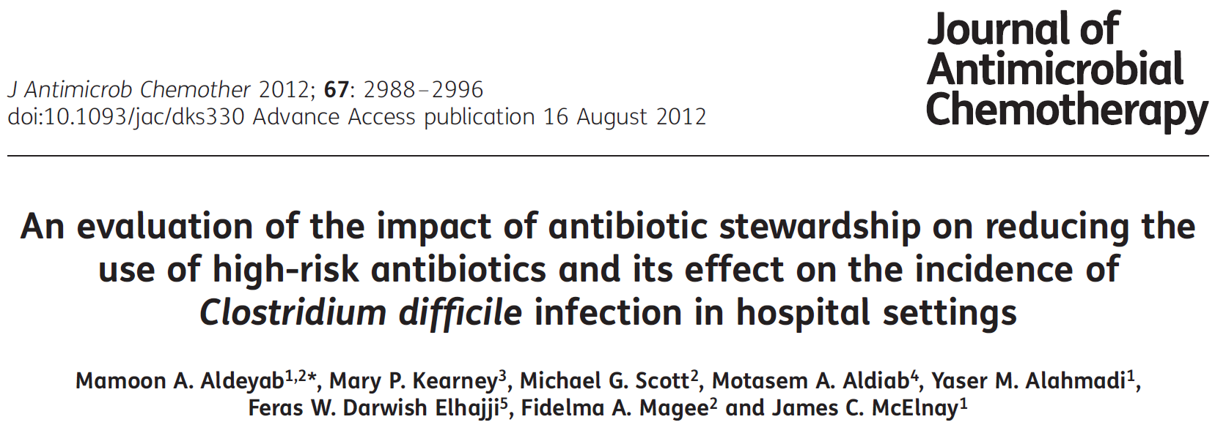
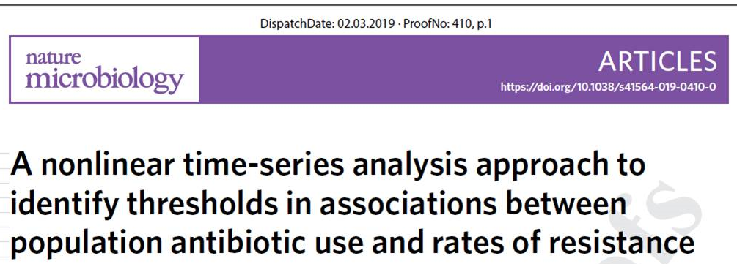
Publications

Slide 9

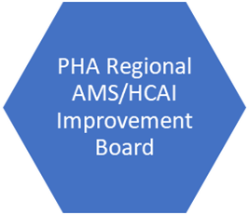
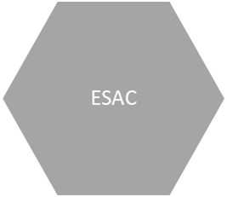
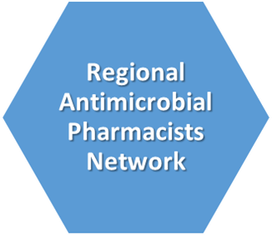



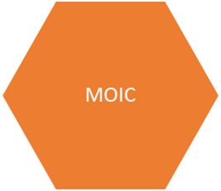
Collaboration- Expert Groups
Neonatal Network
NI
NICPLD
Notes:
Regional OPAT group- now regional OPAT pharmacists
SAMRAHI- shaping police
Improvement board- making policy operational
Improvement board sub- group working on standardising TDM- vancomycin ready, next teicoplanin
NICPLD as previous
RPS- Monthly updates and twice year face-to-face- can bring back to NI potential work !
Neonatal network NI- have worked on the regional neonatal guidelines
ESAC- PPS
MOIC- shaping research

Slide 10
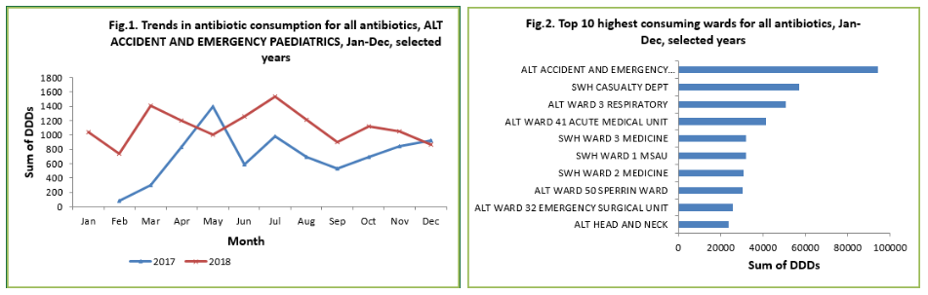
Collaboration With PHA- Hi-Surv dashboard & TM Reports
Notes:
Hi-Surv has provided an interactive database that allows Trust teams to view quality assured antimicrobial usage in real time. The graphs generated can be used in reports. The dashboard reports trends in antimicrobial consumption and Top 10 highest consuming wards on the home page. An example where this improved stewardship was in Emergency Department. This previously was not a focus for work; however Hi- Surv showed it was the highest consumption user. Drilling into the data a particular antibiotic, which the Trusts should conserve, was the largest. This led to a focused audit and the consumption of the drug has been decreasing since.

Slide 11
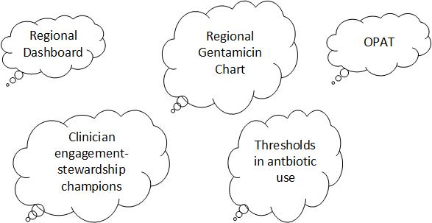

Encompass
The Future?

